Slide 1
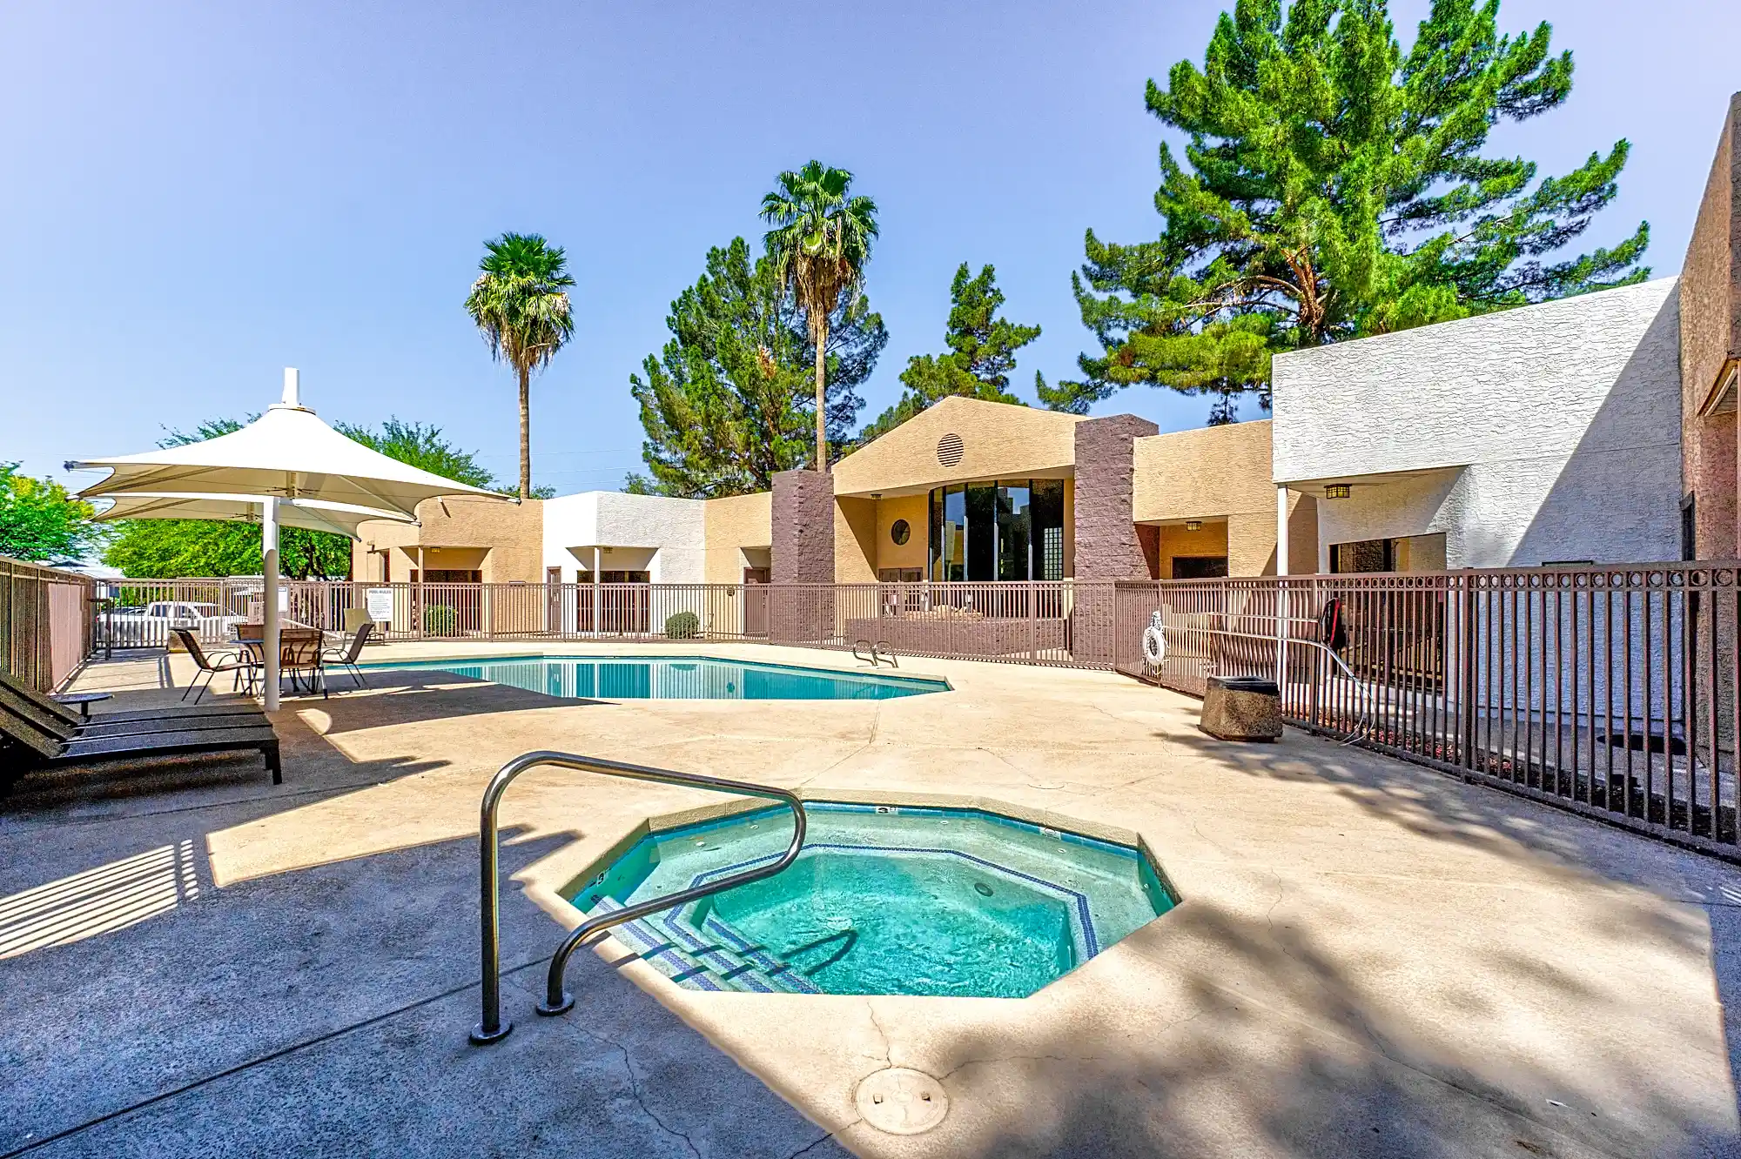

RINCON CAPITAL ADVISORS
Rincon Multifamily Fund II

Slide 2





RINCON CAPITAL ADVISORS
Genesis and leadership
Rincon’s leadership backs their passion for innovation with
75+ years of industry expertise.
The Rincon Multifamily Fund II was built on the team’s shared realization that commercially-owned multifamily housing fills
a unique gap in the American real estate market and is thus poised for rapid growth.
Since inception, Rincon Partners has acquired 26 multifamily properties totaling $638.7 million and has sold 12 properties totaling $386.8 million.
During 2021, Rincon Partners was selected by Canyon Partners to join the California Employees' Retirement System ("CalPERS") Emerging Manager Program and subsequently acquired three (3) multifamily assets within the Phoenix
metro totaling $170.3 million.
Rincon Partners is a fully integrated real estate
investment firm with in-house acquisitions, property management, construction management, financing, accounting, and dispositions.
Kirk McAllaster
President
Christopher S. Cameron
Executive Vice President
& Chief Financial Officer
John M. Pons
Executive Vice President
& Chief Legal Officer
Brian McGlynn
Chief Investment Officer
2
RINCONPARTNERS.COM • © 2025 RINCON PARTNERS, LLC

Slide 3
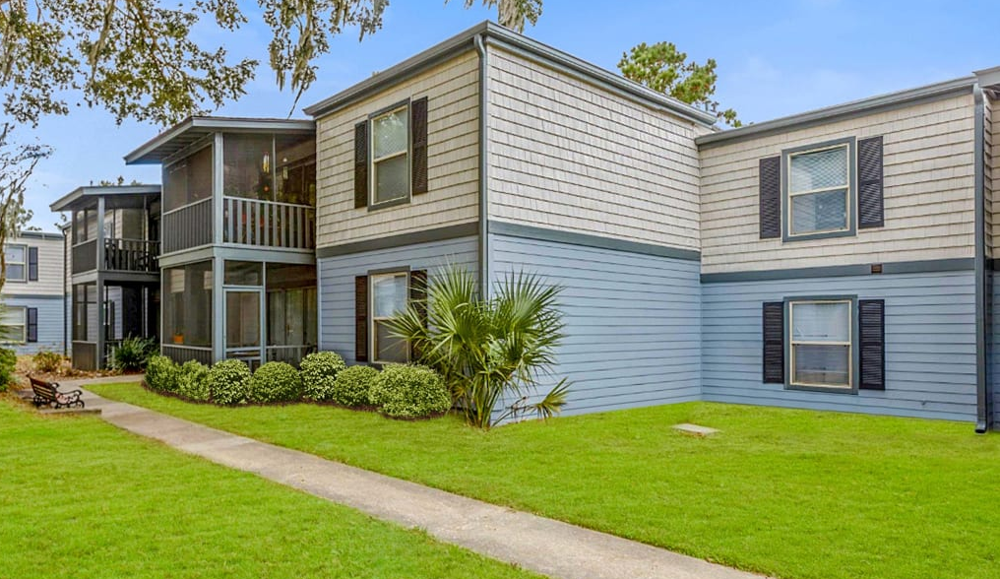
Expertise
Rincon’s principals together have managed over $18+ billion
in commercial real estate assets while holding leading roles
at companies including Cole Real Estate Investments, VEREIT
and CIM Group.
The team’s areas of expertise include:
Acquiring, financing, developing, and selling commercial real estate
Property management (through its PM subsidiary)
Renovation and construction services managed through its in-house construction team.
Institutional quality investment accounting and reporting
PLANTERS TRACE
Charleston, SC
RINCONPARTNERS.COM • © 2025 RINCON PARTNERS, LLC

Slide 4
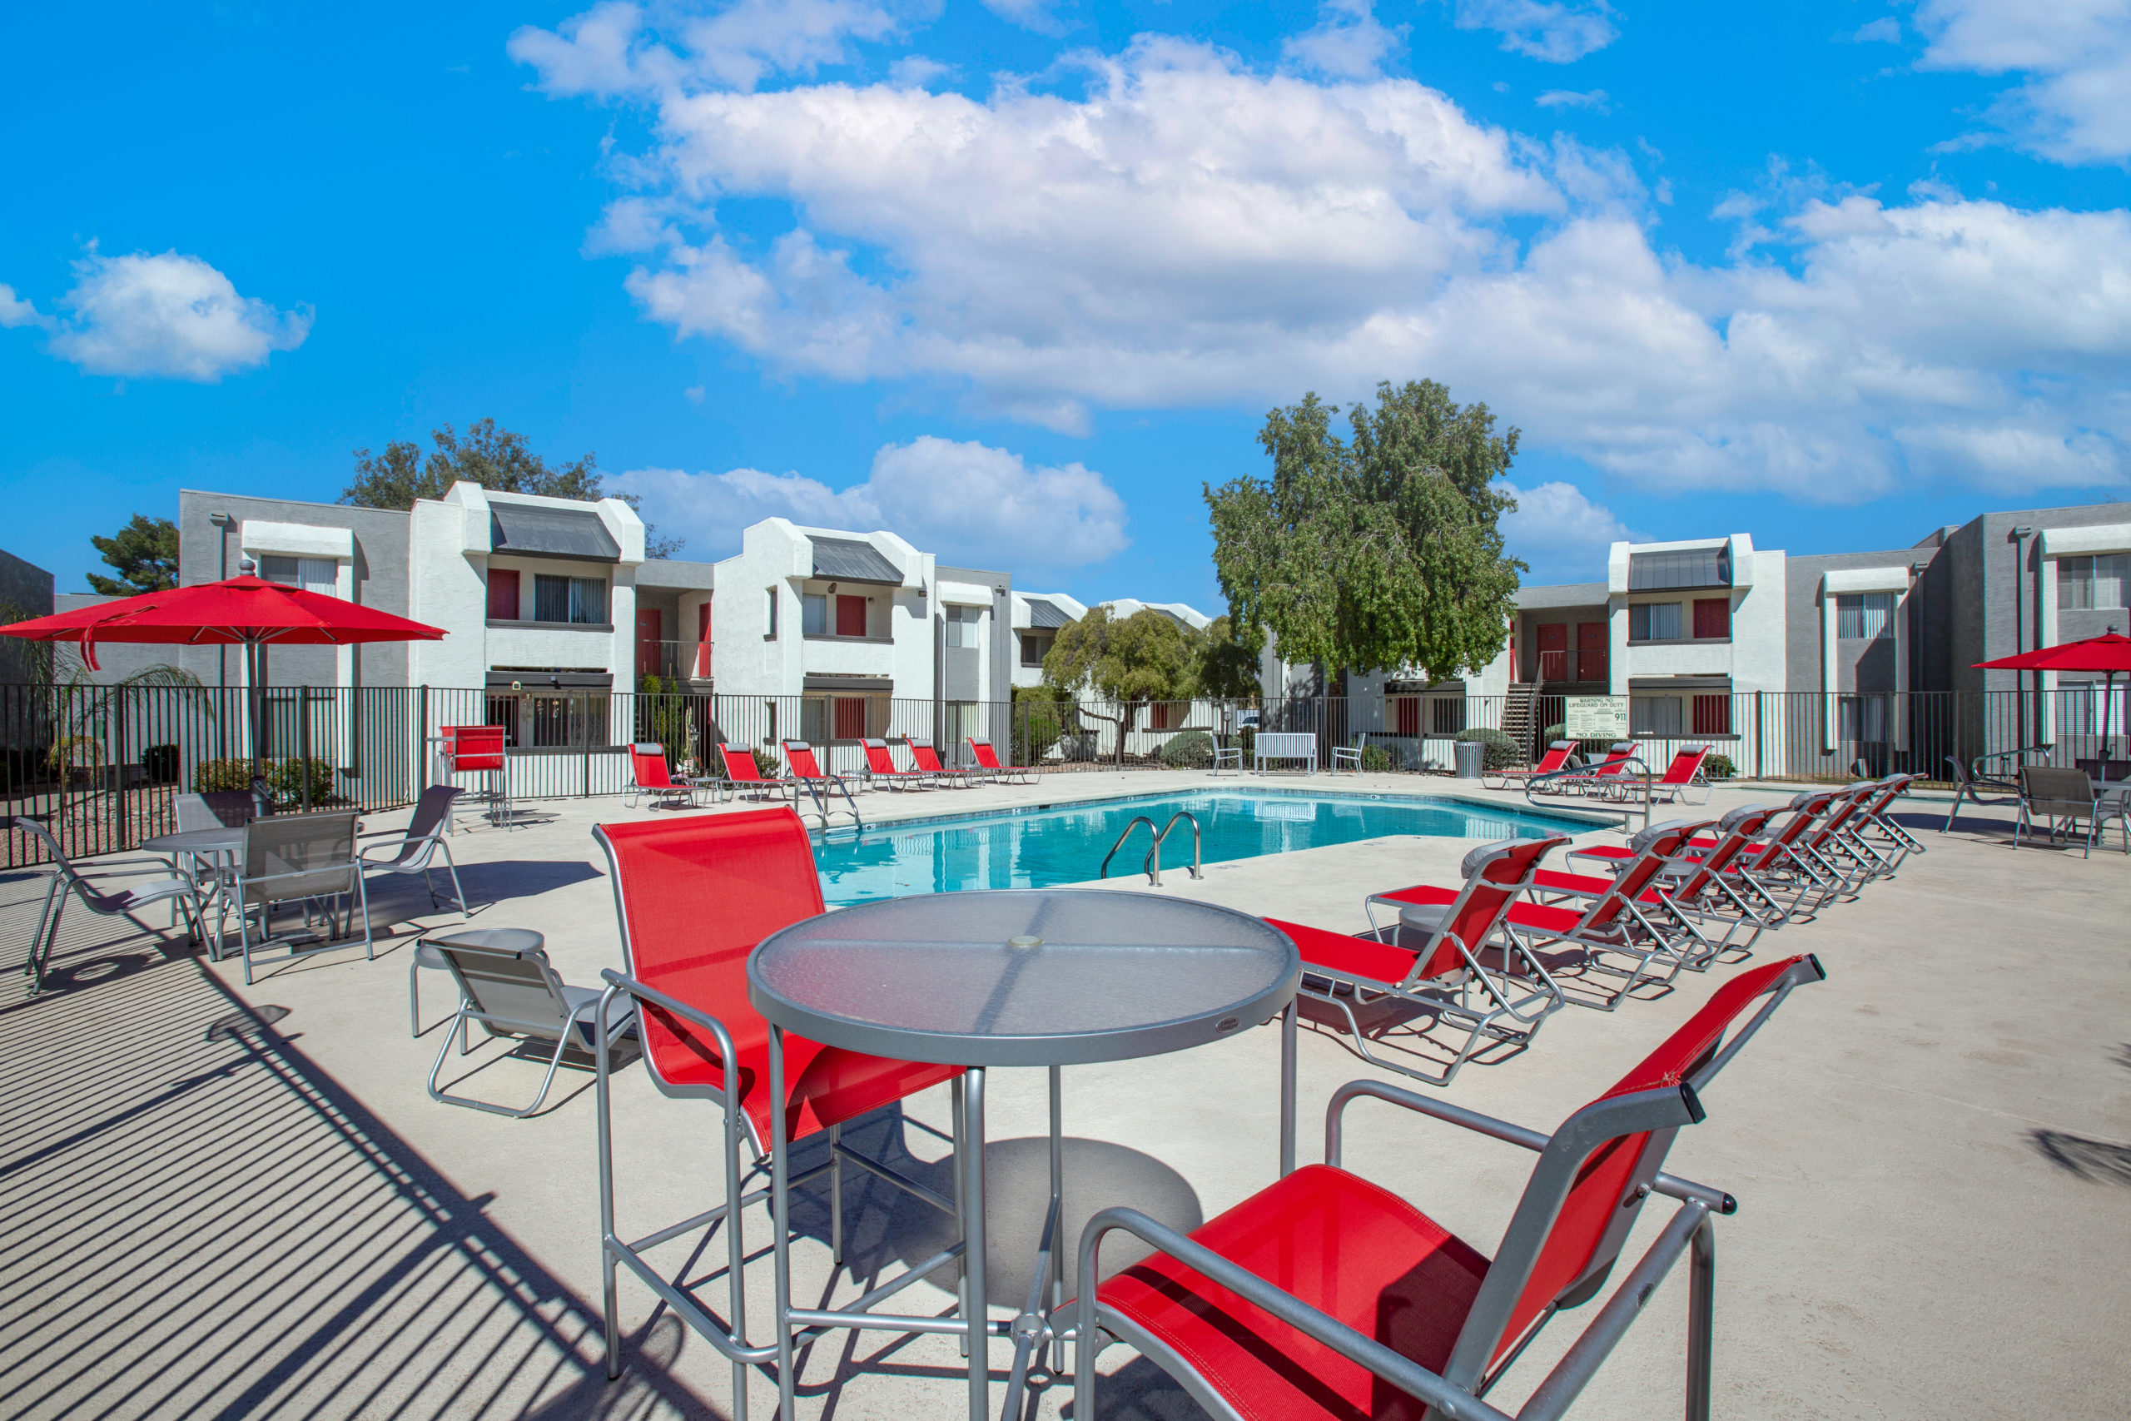
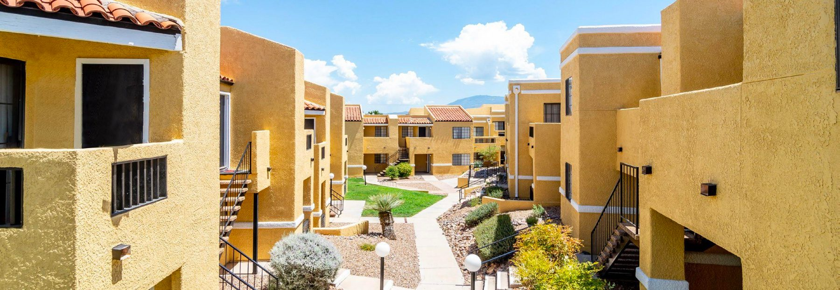
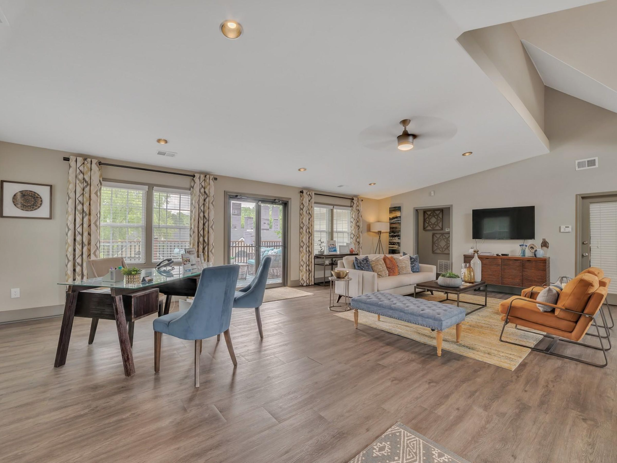
Overview
Rincon Multifamily Fund II LLC (the “Fund”) intends to acquire existing Core Plus and Value-Add multifamily properties that offer income enhancement opportunities through operational improvements, renovations, and repositioning. The properties will be located in the Southwestern and Southeastern regions of the United States.
We intend to aggregate a diversified multifamily portfolio by investing in properties that our manager identifies as having significant capital appreciation potential. Core Plus and Value-Add investments generally consist of properties that provide an opportunity to improve the property’s physical asset, occupancy, financial, operational, or management characteristics to increase cash flow and value.
RINCONPARTNERS.COM • © 2025 RINCON PARTNERS, LLC

Slide 5
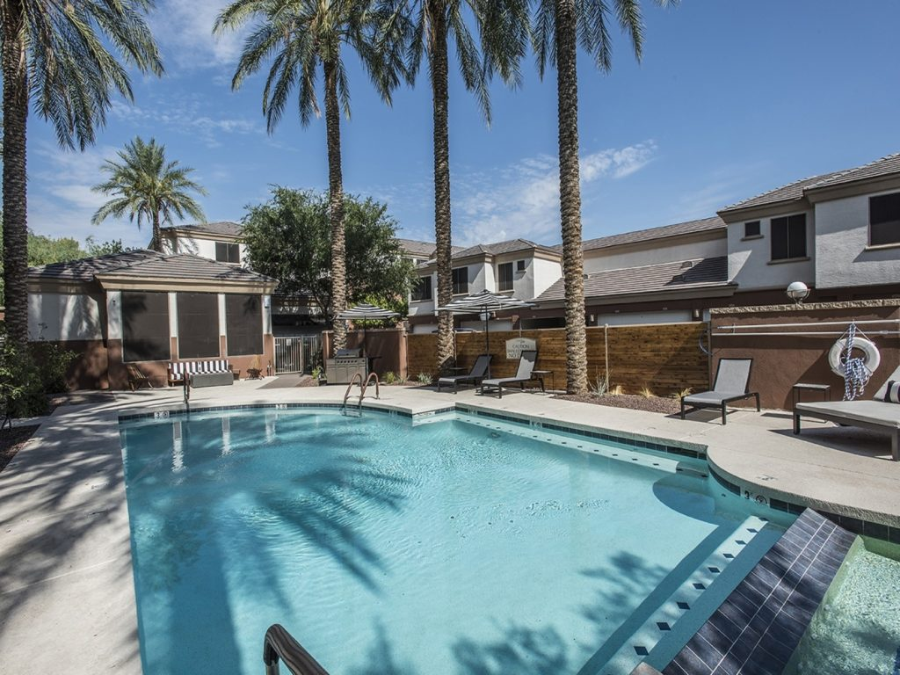
The Investment Strategy
The Rincon Multifamily Fund II will capitalize on market
trends through targeted purchases of multifamily
properties throughout growing suburban and metro areas
in the Southwest and Southeast.
The Rincon Multifamily Fund II is projected to provide cash flow and capital appreciation.
The portfolio will be diversified based on location and multifamily property type.
Range of investments in individual properties: $5-20M
The portfolio will be split across these two property categories: Core Plus & Value-Add
CLARENDON PARK
Phoenix, AZ
RINCONPARTNERS.COM • © 2025 RINCON PARTNERS, LLC

Slide 6
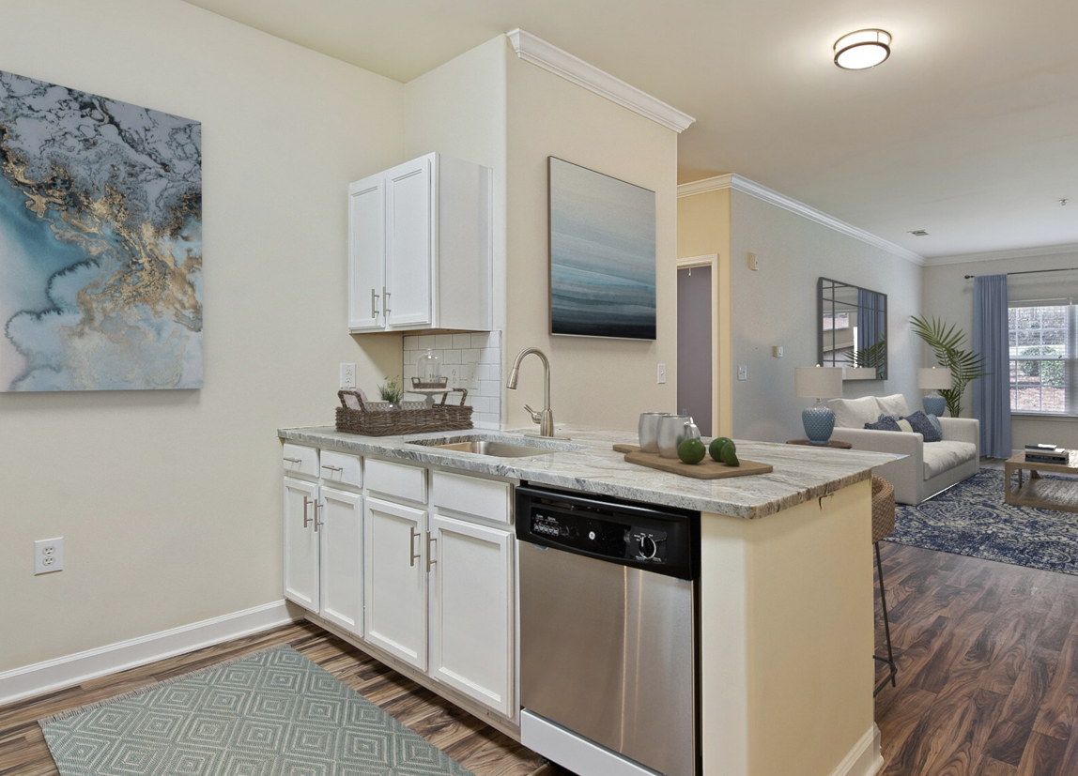
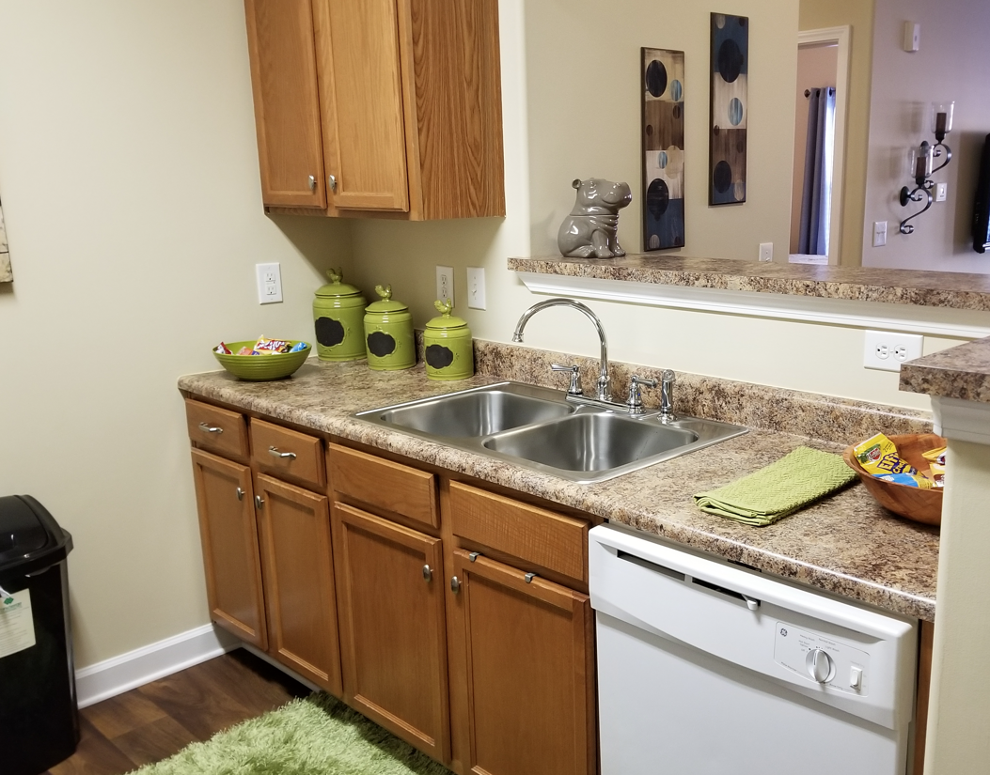
Core Plus Properties
Class A-/B+ Built between 2001 and today
Modest need for improvements to the physical assets Renovations more focused on cosmetic improvements and modernization
Opportunity for operational improvements Increase rents and occupancy and decrease expenses
Higher proportion of annual cash flow Attributable to these properties' stabilized operating cash flows
Before and After
COMMONS at FORT MILL
Fort Mill, SC
6
RINCONPARTNERS.COM • © 2025 RINCON PARTNERS, LLC

Slide 7
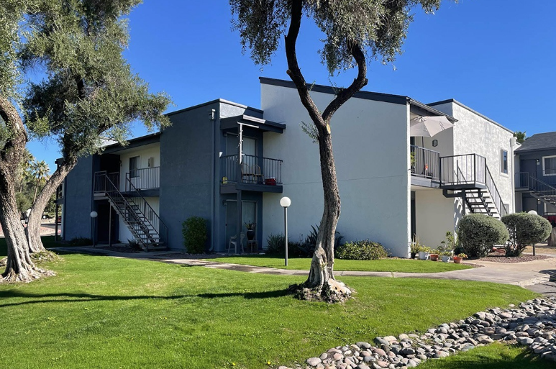
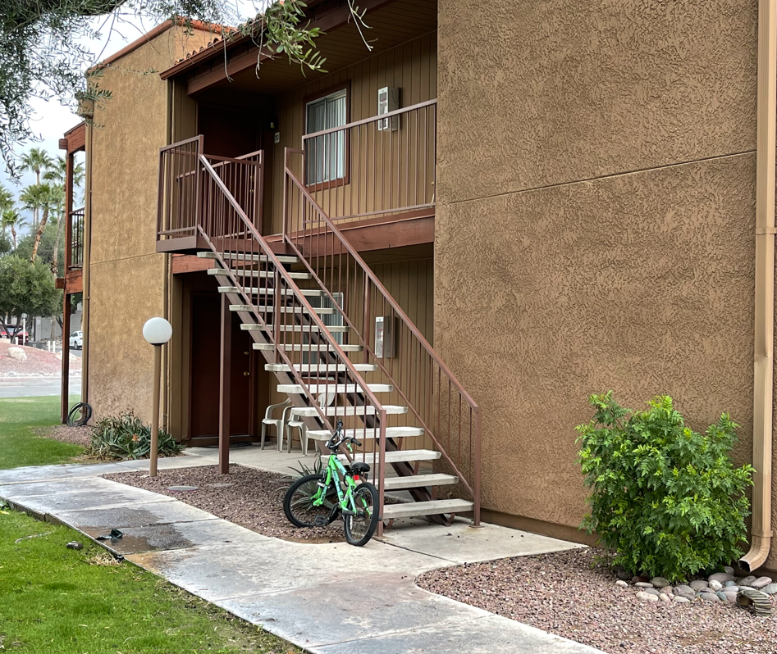
Value-Add Properties
Class B/C built between 1980 and 2000. Can be repositioned to Class B+ through renovations
An opportunity to increase unit-level rents with renovations to the physical asset: Unit interiors, building exteriors, and property amenities
Opportunity for operational improvements Increased occupancy and operating cost reductions
Higher proportion of total return Attributable to these properties' appreciation in value driven by increasing rents and NOI through property renovations and capital expenditures
Before and After
ASCENT on PANTANO
These properties generally have a higher risk
and return profile than Core Plus properties
Tucson, AZ
7
RINCONPARTNERS.COM • © 2025 RINCON PARTNERS, LLC

Slide 8
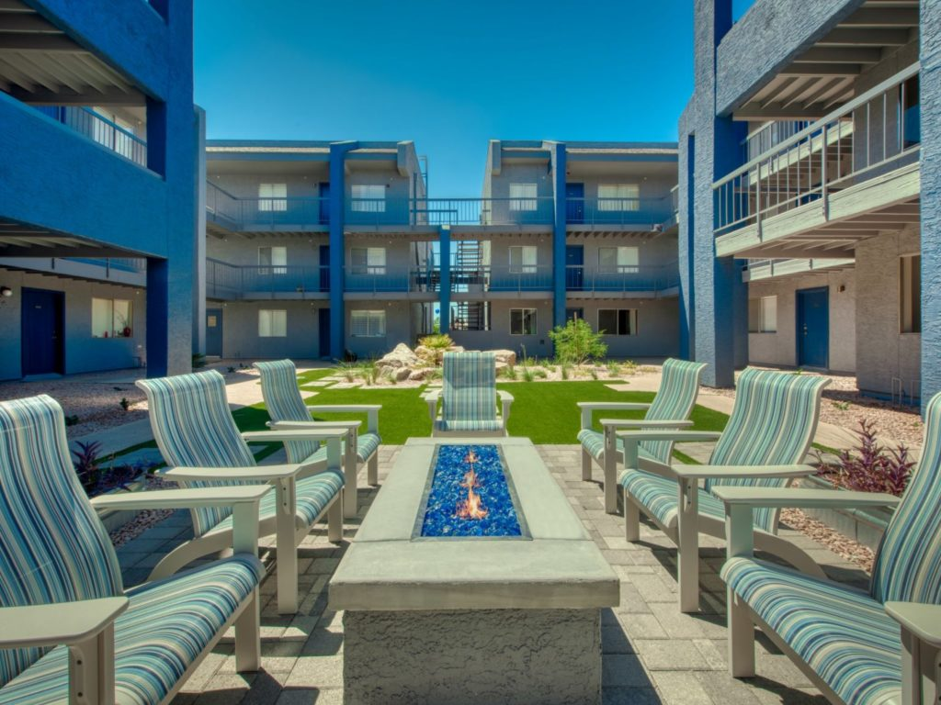
Market opportunity
Continued net in migration to the sunbelt and southwest
has increased single-family home costs and the demand
for multifamily housing.
In the Southeast and Southwest regions, particularly in suburban and secondary markets, data suggest strong demand for higher-quality multifamily housing options.
According to the U.S. Census Bureau, the 10 fastest growing counties and cities from 2022 to 2023 are all located in the southwestern and southeastern states: Texas, Arizona, Florida, and South Carolina. In addition, North Carolina and Georgia registered in the top 10 states for overall population growth from 2022-2023.
The Rincon team has a track record of success in increasing revenue and valuations of multifamily properties.
AVENEL on 16th
Phoenix, AZ
RINCONPARTNERS.COM • © 2025 RINCON PARTNERS, LLC

Slide 9
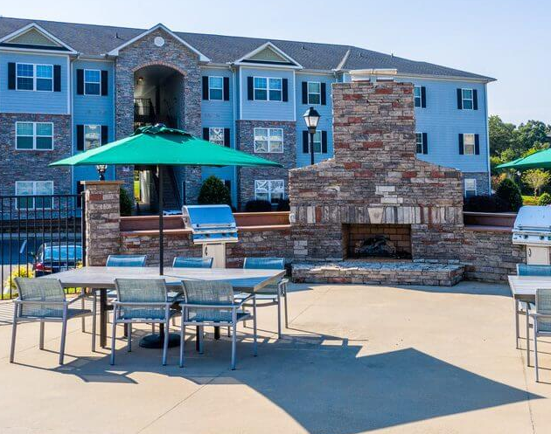
Multifamily opportunity
The five (5) main types of real estate investment properties include multifamily, industrial, office, retail and hotels. Multifamily properties have historically been the most resilient investments. Whether the economy is good or bad, there has always been a demand for housing.
Multifamily properties attract a large pool of renters, reducing vacancy risk and providing stable rental income.
Rising single-family home costs lead to more renters in multifamily properties, increasing demand and potential returns.
The U.S. has been experiencing a housing shortage that benefits multifamily properties in the long-term. Single-family home prices have become out of touch for many U.S. residents and families, largely due to low supply as U.S. homebuilders did not catch up on annual new home starts since the Great Financial Crisis of 2007-2009 and increased mortgage rates. Freddie Mac estimates the U.S. has a shortage of 3.7 million rental units (11/26/2024).
Multifamily investment properties can often effectively manage inflationary environments. The typical multifamily tenant lease runs 12 months and individual lease expiration dates are generally staggered throughout the year. As operational costs increase, multifamily owners have the flexibility to raise rents and manage NOI.
Compared to other real estate investments, multifamily properties are generally more liquid, allowing for easy buying and selling due to high demand and standardized financing options.
COMMONS at FORT MILL
Fort Mill, SC
RINCONPARTNERS.COM • © 2025 RINCON PARTNERS, LLC

Slide 10
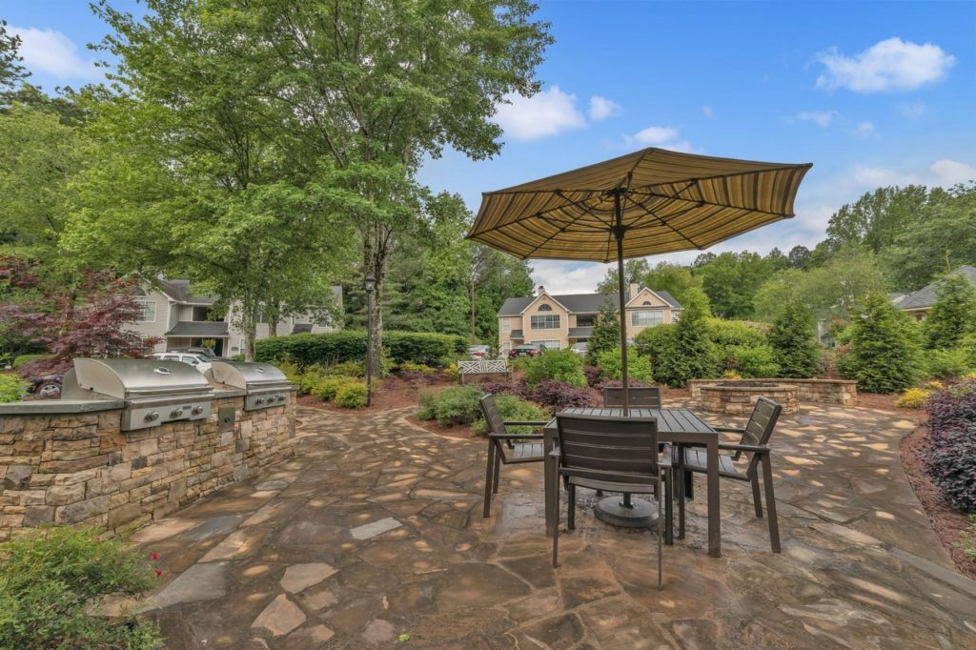




Property Acquisition Strategy
The Rincon team will draw on an extensive network
of commercial real estate brokers in the target regions
to identify high-potential properties as well as its deep knowledge of its target markets to identify potential
off-market transactions.
  Discount to
  replacement cost
  Geographic
  diversification
  Strong market
  fundamentals
  Area
  demand
DECATUR FLATS
Decatur, GA
RINCONPARTNERS.COM • © 2025 RINCON PARTNERS, LLC

Slide 11
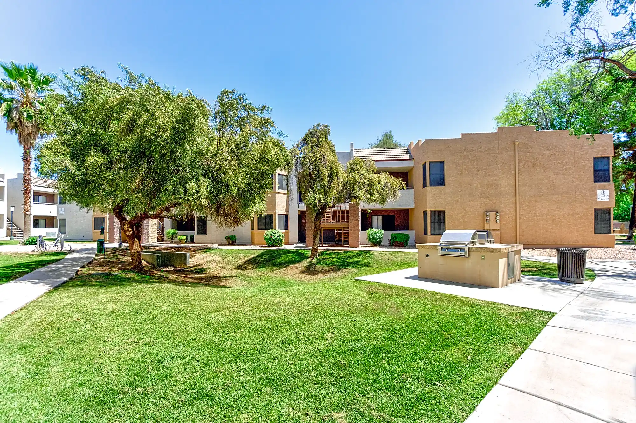
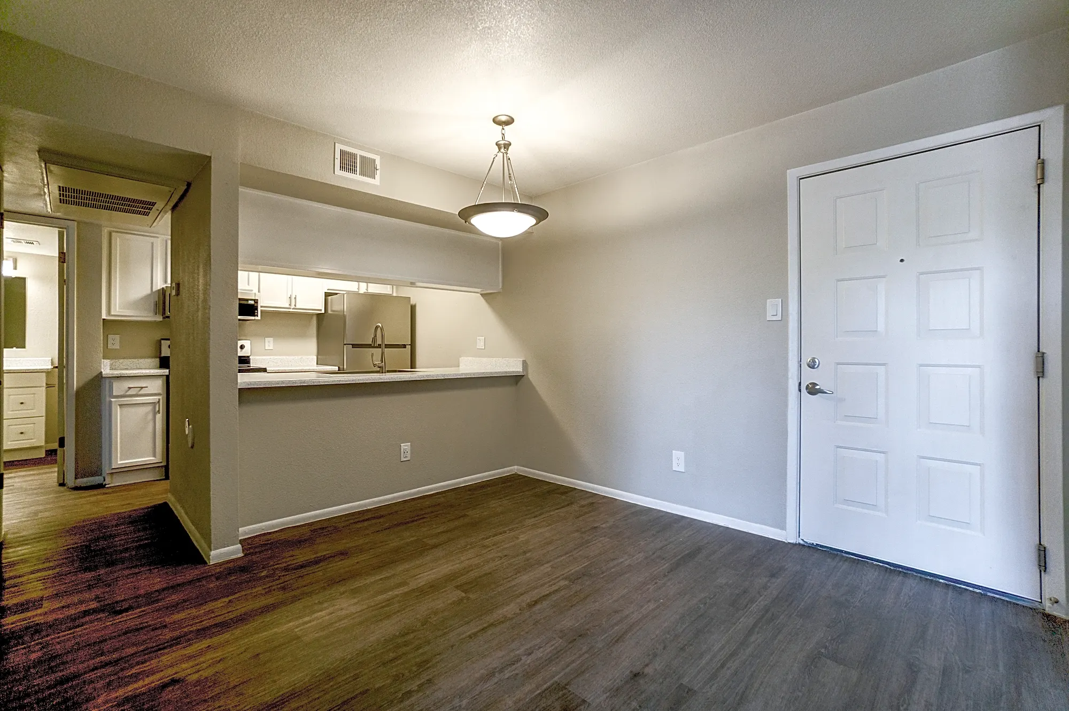
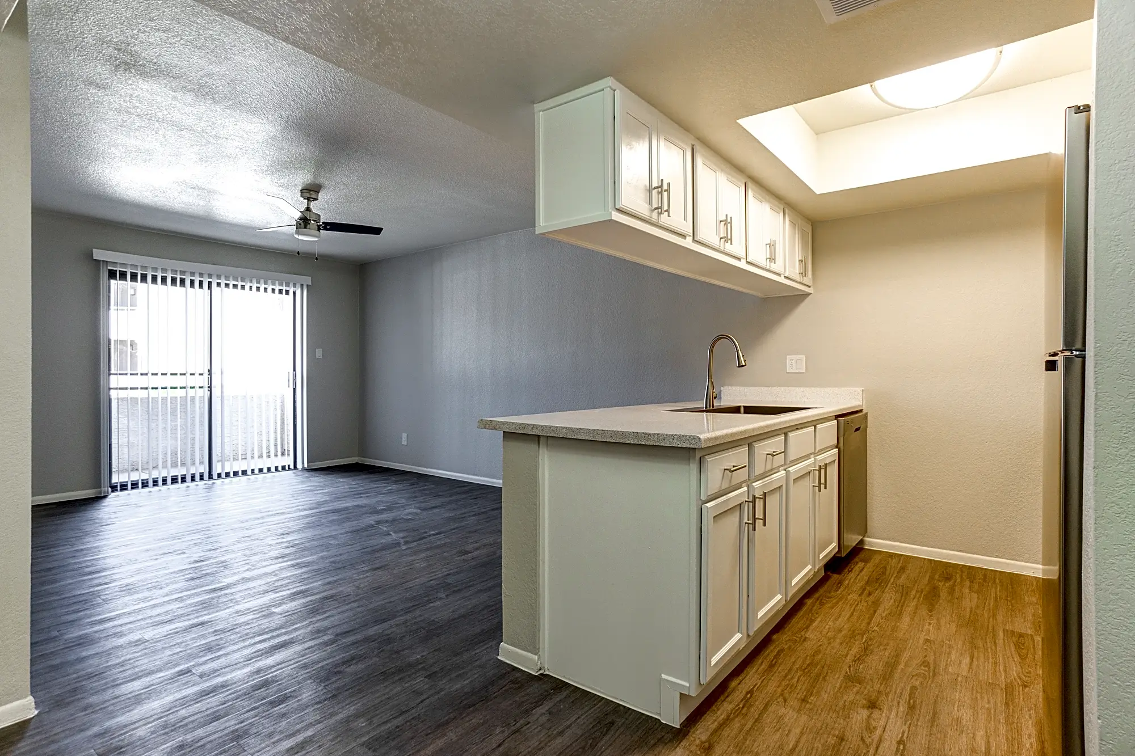
Recent Acquisition
Ascent on Spence - Tempe, Arizona
On December 5, 2024, the Fund acquired a 112-unit Value-Add multifamily property constructed in 1986 and located in Tempe, Arizona, previously known as Rancho Las Palmas (the “Property”) and now renamed as Ascent on Spence. The Fund acquired the Property for a contract purchase price of $18,000,000, excluding closing costs.
The Fund financed the purchase price of the Property with a combination of (1) proceeds from the offering and (2) a $14,000,000 loan from the seller with monthly interest-only payments at a fixed rate of 7.50% per annum. The loan matures on December 4, 2026 and can be prepaid at any time.
The Property is centrally located in Tempe, Arizona, approximately 0.75 miles southeast of Arizona State University’s main campus with an enrollment of over 56,600 students. In addition, the Property is located within 2.5 miles of the Loop 101 Price Freeway, the Loop 202 Red Mountain Freeway and the Hwy 60 Superstition Freeway, all of which provide easy access to major employment corridors throughout the Phoenix MSA.
RINCONPARTNERS.COM • © 2025 RINCON PARTNERS, LLC

Slide 12
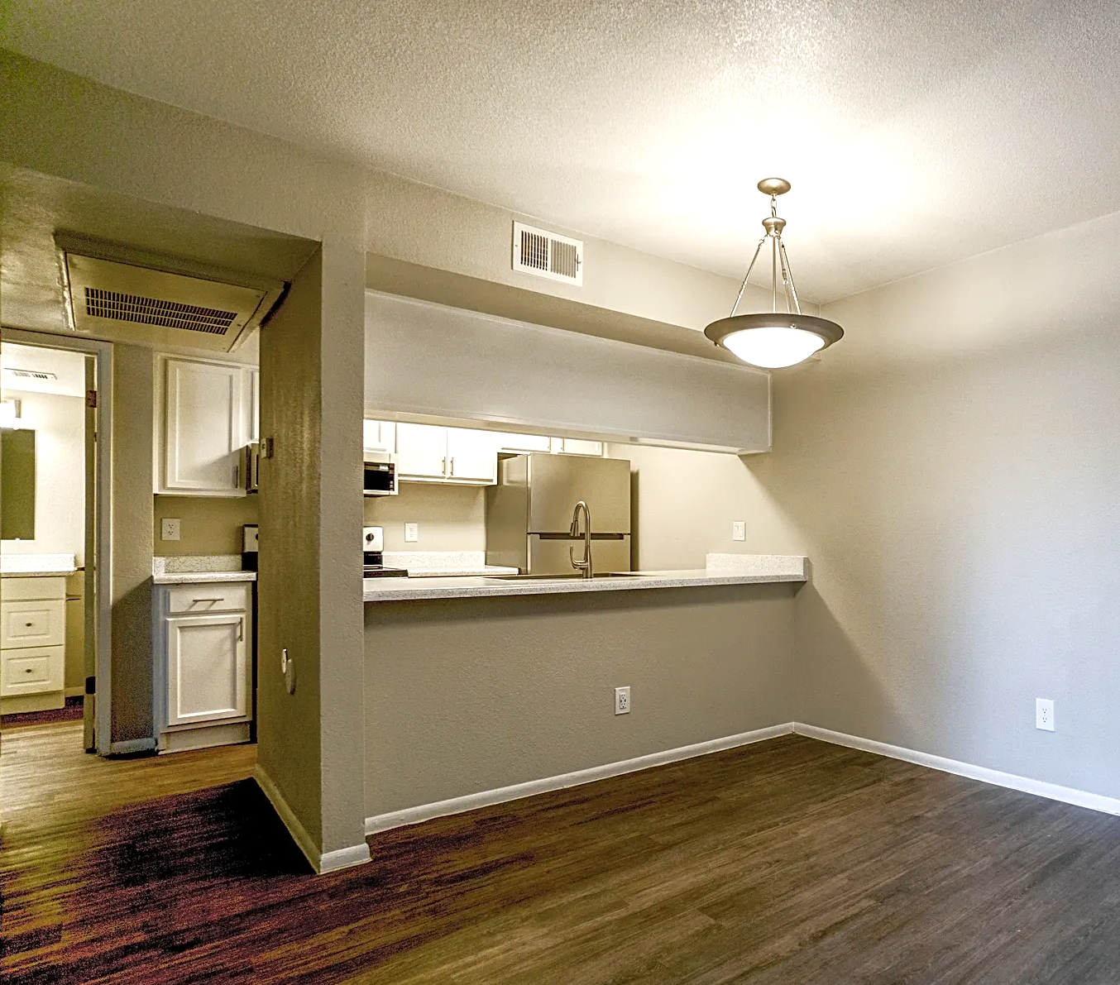
Value-Add Ascent on Spence
Operational Enhancements Rincon’s in-house management team will revitalize leasing strategies, create an online presence, introduce market-rate utility reimbursements, and stabilize operational expenses
Improvements Landscaping, pool enhancements, dog park, and new monument signage
Rebranding Effort Repositioning Ascent on Spence as a sought-after multifamily community, emphasizing its affordability
Strong Market Fundamentals The North Tempe submarket continues to benefit from steady demand bolstered by a thriving local economy, population growth, and ASU
Before and After
ASCENT on SPENCE
These properties generally have a higher risk
and return profile than Core Plus properties
Tempe, AZ
12
RINCONPARTNERS.COM • © 2025 RINCON PARTNERS, LLC

Slide 13
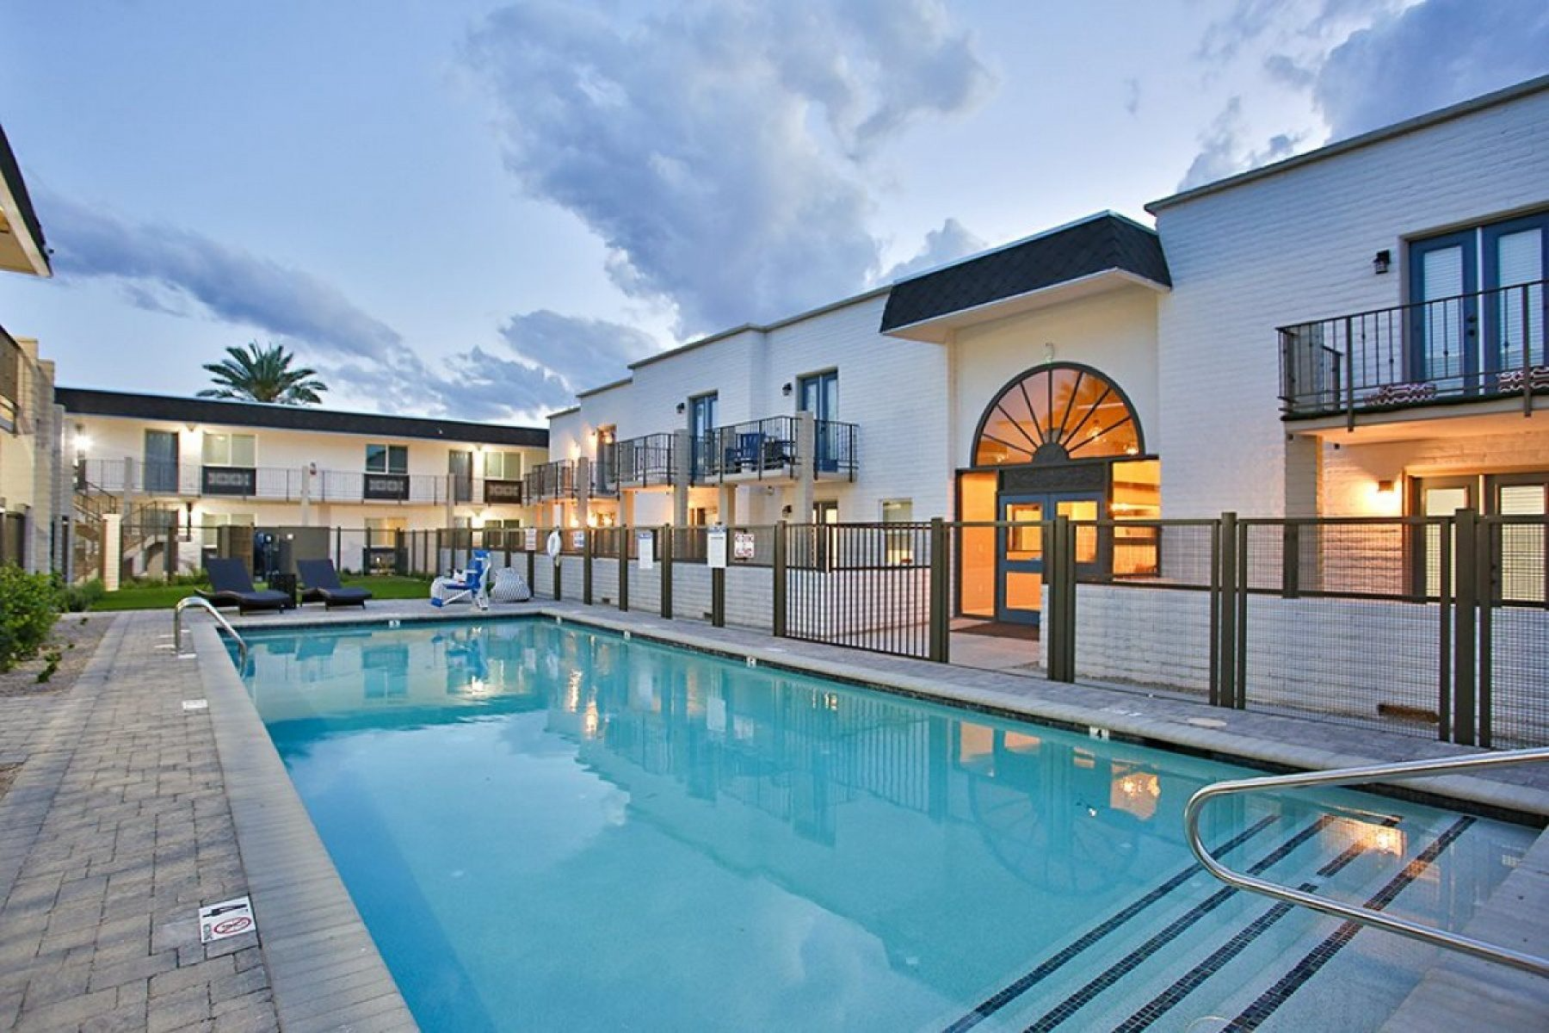
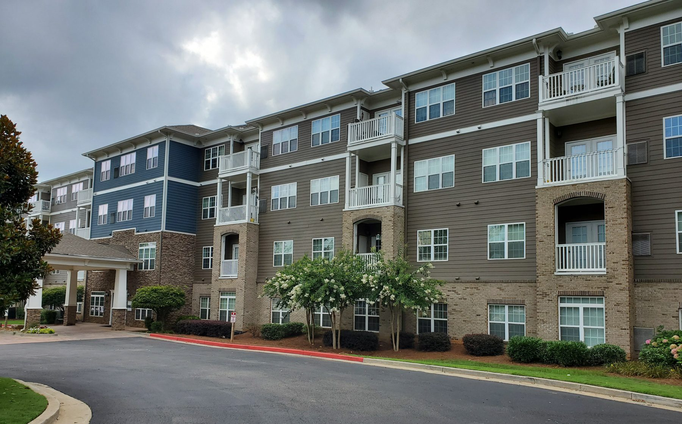
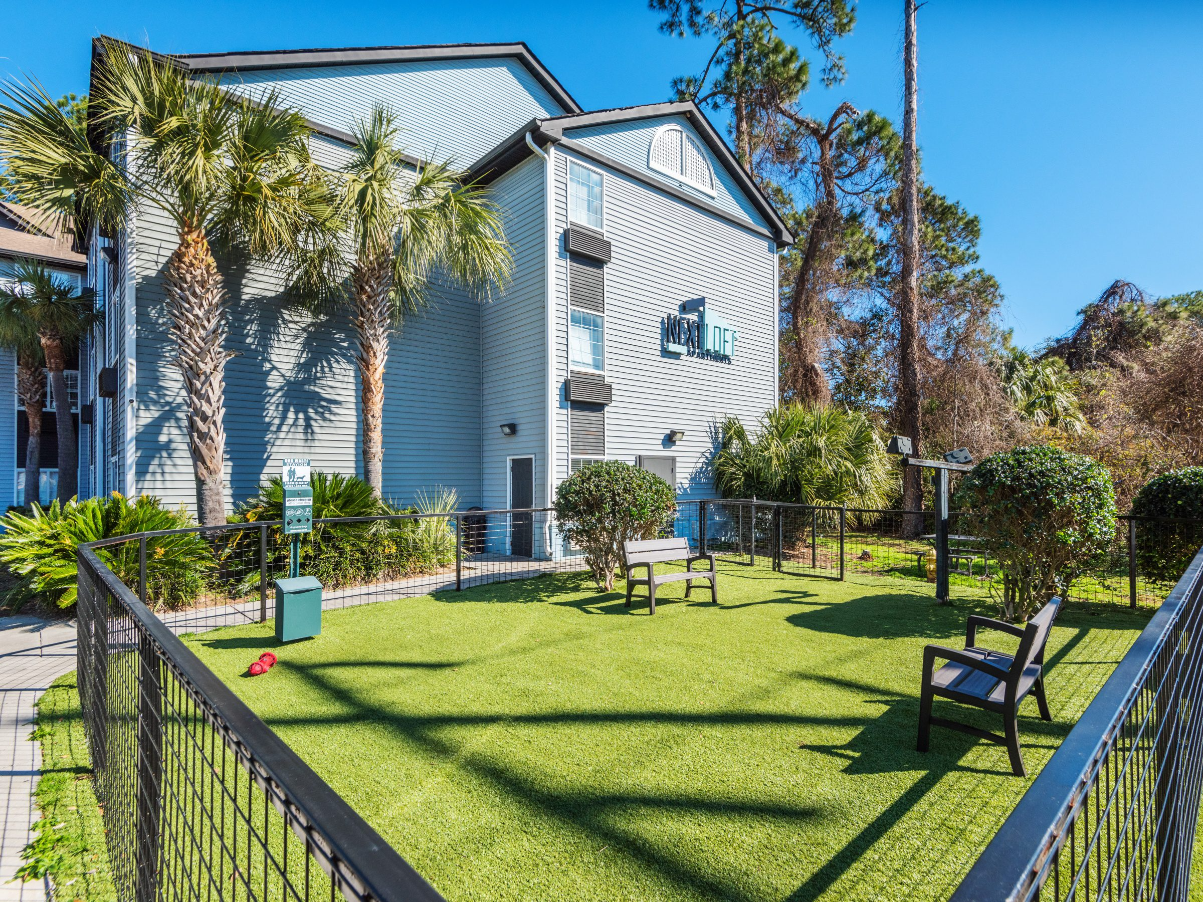

The Fund Offer
Potential Benefits Portfolio diversification without the public market exposure of a REIT
Higher-yielding, income-producing hard assets
Geographically diversified real estate investment in growth areas
Potential investor tax benefits include depreciation, operating expense deductions, and beneficial passive income tax treatment
We are offering a maximum of $100,000,000 of our limited liability company interests of Class A units at a purchase price of $1,000.00 per unit.
As of December 6, 2024, the Fund has raised $5,000,000 in the Offering. The Fund satisfied its minimum offering requirement and broke escrow on December 3, 2024.
We intend to finance our portfolio at a target leverage level of between 50% and 65% loan-to-value.
The initial minimum investment is $50,000 in Class A Units. Additional purchases must be made in increments of at least $5,000.
We expect the average cost of our properties to be between $10 million
and $40 million.
As an exit strategy, our objective is to stage the assets for disposition at an optimal time to return unit holder capital to maximize profits. We expect to hold each individual property for approximately three to five years before selling the property.
We operate under the direction of our manager (Rincon Fund Advisor II, LLC), who is responsible for the management and control of our affairs.
RINCONPARTNERS.COM • © 2025 RINCON PARTNERS, LLC

Slide 14
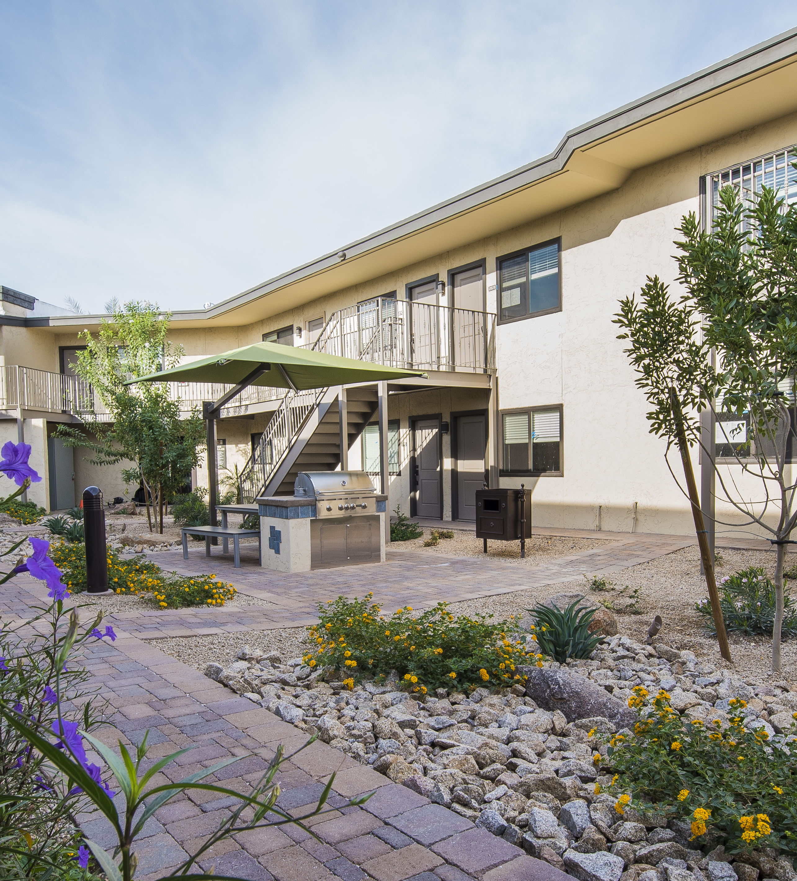
Investor Benefits
Portfolio diversification without the stock market exposure of a REIT
Higher yielding, income producing hard assets
Geographically diversified real estate investment in growth areas
Committed management with a track record of success
Regional expertise and network
Transparency and access to investment managers
Lower fee structure
Targeted fund holding period of 3-5 years
MADISON GROVE
Phoenix, AZ
14
RINCONPARTNERS.COM • © 2025 RINCON PARTNERS, LLC

Slide 15
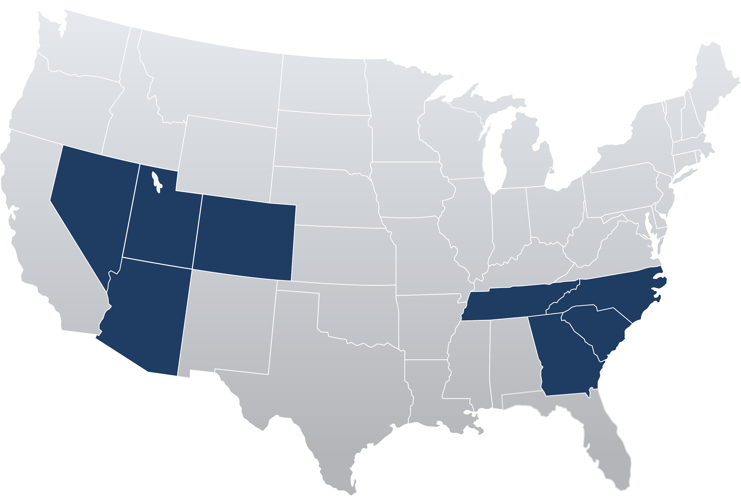
The Fund at-a-glance
The Rincon Multifamily Fund II is a boutique private real estate offering that targets both sustainable income and property
valuation growth.
Fund size $100M
Target holding period 3-5 years
Income payouts to investors Quarterly
Southwest target markets
Phoenix, AZ | Colorado Springs, CO
Tucson, AZ | Las Vegas, NV
Denver, CO | Reno, NV
Southeast target markets
Nashville, TN | Greenville, SC
Chattanooga, TN | Columbia, SC
Atlanta, GA | Charlotte, NC
Savannah, GA | Raleigh/Durham, NC
Charleston, SC
It is a great time to invest in Multifamily Properties. Overall vacancies are low from a historical perspective,
rents are forecasted to increase with U.S. inflation, the increasing cost of single-family homes and overall
home ownership costs are pushing more potential home buyers into renting, and decades of
underinvestment and underbuilding has created a shortage of housing the U.S.
RINCONPARTNERS.COM • © 2025 RINCON PARTNERS, LLC

Slide 16
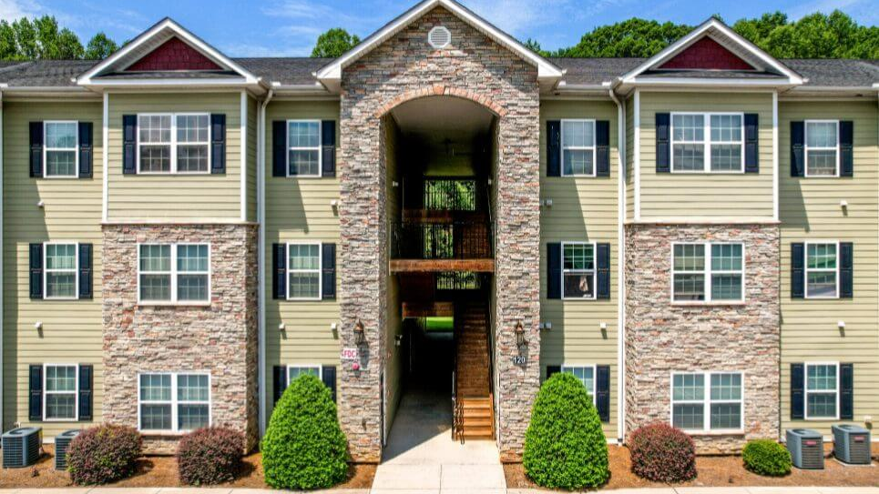
Delivering consistent investor returns
Property Name | # Units | Year Built | Acq. Date | Sold Date | Acquisition Price | Renovation Cost | Total Cost | Sold Price | Gross IRR | Gross Multiple
Rincon 22 | 11 | 1970 | Nov-15 | Apr-17 | $775,000 | $554,828 | $1,329,828 | $1,578,760 | 18.3% | 1.32x
Clarendon Park | 138 | 2002 | Mar-17 | Dec-18 | $17,500,000 | $1,700,743 | $19,200,743 | $23,850,000 | 30.3% | 1.59x
Crossroads | 316 | 1982 | Aug-16 | Jan-19 | $25,200,000 | $0 | $25,200,000 | $33,500,000 | 22.4% | 1.57x
Centerra | 202 | 1986 | Aug-17 | Oct-19 | $25,950,000 | $3,673,980 | $29,623,980 | $36,250,000 | 29.8% | 1.76x
Avenel on 16th | 200 | 1981/1984 | Aug-18 | Aug-20 | $16,050,000 | $4,128,933 | $20,178,933 | $25,950,000 | 37.1% | 1.86x
Sunset Hills | 120 | 1988 | Jan-19 | Dec-20 | $17,800,000 | $503,776 | $18,303,776 | $22,800,000 | 34.9% | 1.76x
Enclave at Paradise Valley | 174 | 1985 | Feb-19 | May-21 | $24,000,000 | $2,675,290 | $26,675,290 | $37,610,000 | 54.1% | 2.47x
Galeria del Rio | 101 | 2014 | Mar-16 | Jul-21 | $19,300,000 | $0 | $19,300,000 | $32,025,000 | 22.1% | 2.61x
Commons at Fort Mill | 144 | 2009 | May-19 | Jul-21 | $19,280,000 | $1,801,387 | $21,081,387 | $25,650,000 | 23.4% | 1.56x
Alterra (fka, Los Portales) | 416 | 1989 | Nov-19 | Mar-22 | $40,000,000 | $3,885,457 | $43,885,457 | $81,500,000 | 103.9% | 5.04x
Madison Grove | 171 | 1976/2016 | Jan-18 | May-22 | $21,450,000 | $0 | $21,450,000 | $51,300,000 | 54.5% | 5.92x
Arcadia Gardens | 76 | 1969/2016 | Nov-17 | Mar-24 | $8,475,000 | $0 | $8,475,000 | $14,750,000 | 28.9% | 3.74x
Total | 2,069 |  |  |  | $235,780,000 | $18,924,394 | $254,704,394 | $386,763,760 | 38.3% | 2.60x
RINCONPARTNERS.COM • © 2025 RINCON PARTNERS, LLC

Slide 17
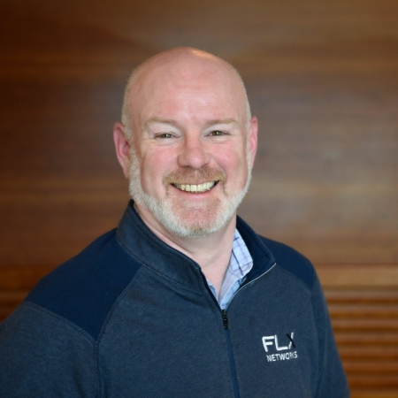
Partnering with FLX Networks
Rincon Multifamily Fund II, LLC is proud to collaborate with FLX Networks, a trusted leader in distribution services for the financial services industry. As a Promoter under the U.S. Investment Advisers Act of 1940, FLX Networks leverages its affiliation with a FINRA-registered broker-dealer to connect investors with exclusive opportunities like ours. This strategic partnership ensures streamlined access to the Fund, enhancing investor engagement while upholding the highest industry standards.
For more information on investing through FLX Networks, contact John Feeley at
tel: 908.944.7917 or at John.Feeley@flxnetworks.com
Contact us
D. Kirk McAllaster, Jr.
President
480.378.2951
kmcallaster@rinconpartners.com
Brian McGlynn
Chief Investment Officer
480.378.2959
bmcglynn@rinconpartners.com
PHOENIX
11811 N. Tatum Blvd.
Suite 2500
Phoenix AZ 85028
480.378.3070
RINCONPARTNERS.COM • © 2025 RINCON PARTNERS, LLC

Slide 18
Disclosures
This material is neither an offer to sell nor an offer to buy securities of Rincon Multifamily Fund II, LLC (“The Fund”, “us” or “we”). An offering is made only by the confidential private placement memorandum which will be sent upon request. This material must be read in conjunction with the confidential private placement memorandum in order to fully understand all of the implications and risks of the offering of securities to which the private placement relates. A copy of the private placement memorandum must be made available to you in connection with any offering. Neither the Securities and Exchange Commission, the Attorney General of the State of New York nor any other state securities regulator has approved or disapproved of our membership interests, determined if the confidential private placement memorandum is truthful or complete or passed on or endorsed the merits of this offering. Any representation to the contrary is a criminal offense. No assurance can be given that the investment objectives will be achieved. The material does not contain all of the information and risk factors that would be important to an investor in making an investment decision and is not an offer to sell a security or the solicitation of an offer to buy a security. This document and its contents are strictly confidential.
This presentation includes forward-looking statements that can be identified by the use of words such as “will,” “may,” “should,” “intend,” “believe,” “expect,” “could,” “target,” “estimates,” “projects” or other comparable terminology. Statements concerning projections, future performance, cash flows and any other guidance on present or future periods constitute forward-looking statements. Forward-looking statements involve significant risks and uncertainties, and you should not unduly rely on these statements. You should be aware that a number of important factors, including but not limited to, the factors in our private placement memorandum, could cause our actual results to differ materially from those in the forward-looking statements. The statements made herein are as of January 2024 and we undertake no obligation to update these statements except as may be required by applicable securities laws.
Past performance of Rincon Partners, LLC (“Rincon”) may not be a good measure of our future results and there is no assurance that we will be able to meet our investment objectives.
Certain pictures are presented for illustrative purposes only. An investment in The Fund is not an investment in any of these properties unless explicitly designated as an existing investment of Rincon Multifamily Fund II and not Rincon or other funds or properties Rincon may operate.
RINCONPARTNERS.COM • © 2025 RINCON PARTNERS, LLC
JAN - 25

Slide 20
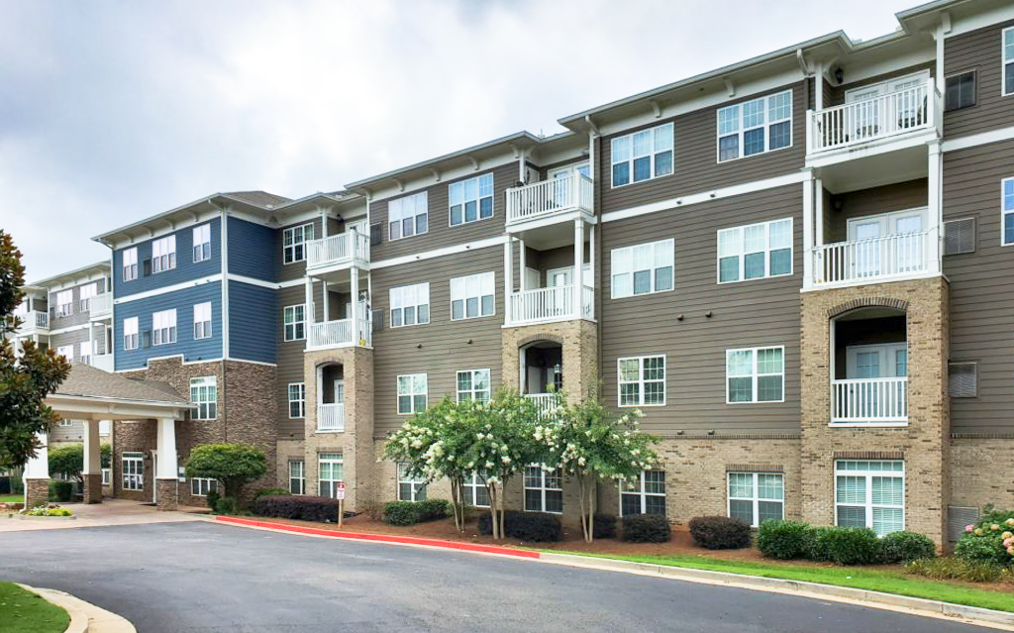
Target Performance:
Core Plus
The Rincon Multifamily Fund II performance targets are based
upon performance projections for the two real estate asset classes
in its portfolio.
7-11%
Annual gross profit (starting year 1)
0% | 1% | 2% | 3% | 4% | 5% | 6% | 7% | 8% | 9% | 10% | 11% | 12% | 13%
ASPECT on the RIVER
Canton, GA
20
RINCONPARTNERS.COM • © 2025 RINCON PARTNERS, LLC

Slide 21
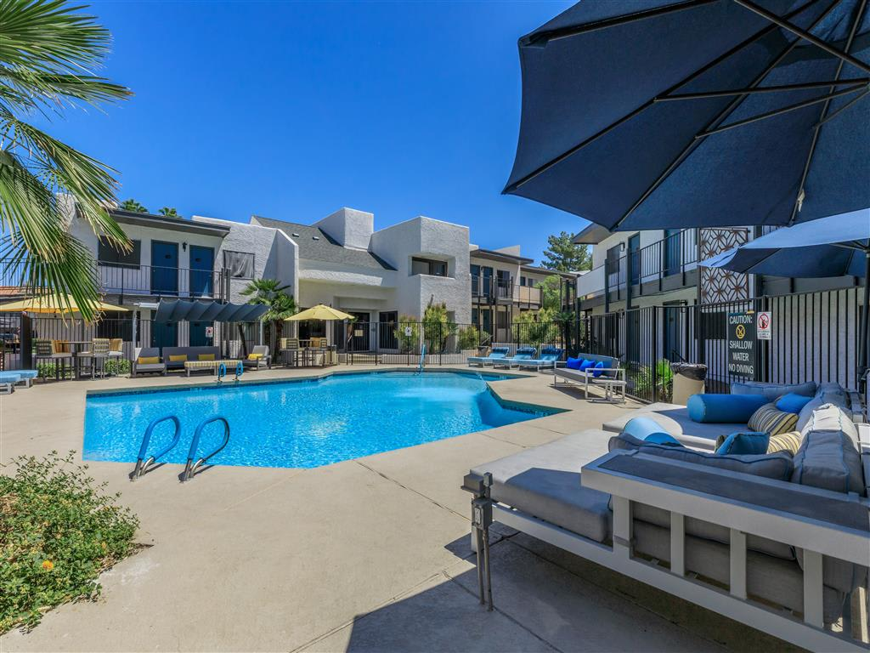
Target Performance:
Value-Add
The Rincon Multifamily Fund II performance targets are based
upon performance projections for the two real estate asset classes
in its portfolio.
0-5%
8-12%
Gross profit year 1 (starting year 1)
Annual gross profit thereafter
0% | 1% | 2% | 3% | 4% | 5% | 6% | 7% | 8% | 9% | 10% | 11% | 12% | 13% | 14%
Target
profit
Target
distribution
ASCENT 1829
Canton, GA
21
RINCONPARTNERS.COM • © 2025 RINCON PARTNERS, LLC

Slide 22
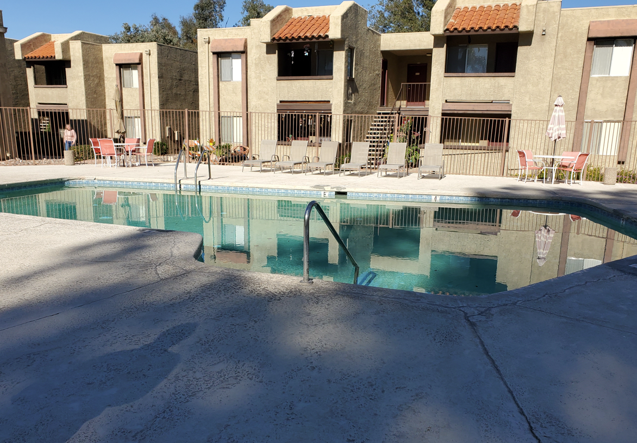
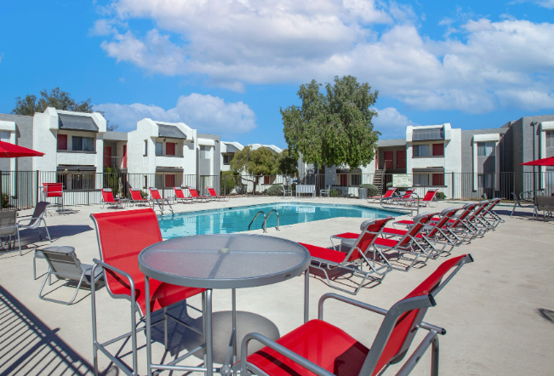
The Vintage – Tucson, AZ
Before
After
RINCONPARTNERS.COM • © 2025 RINCON PARTNERS, LLC

Slide 23
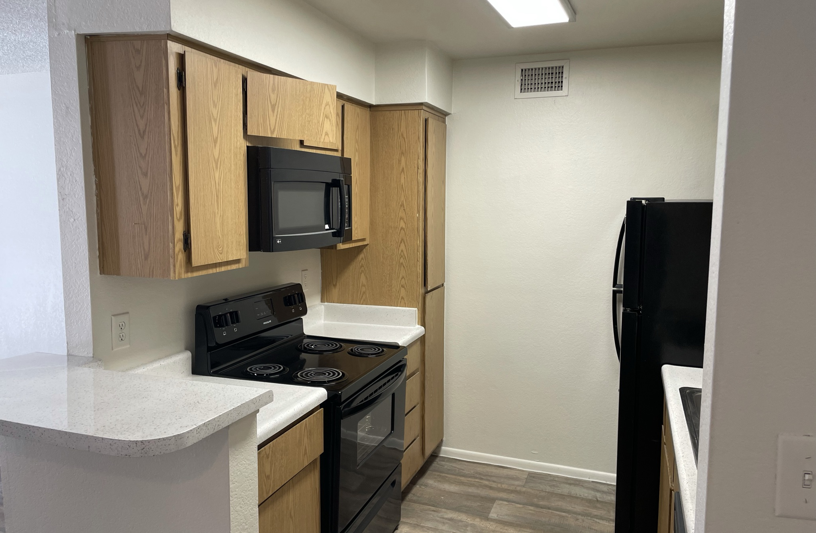
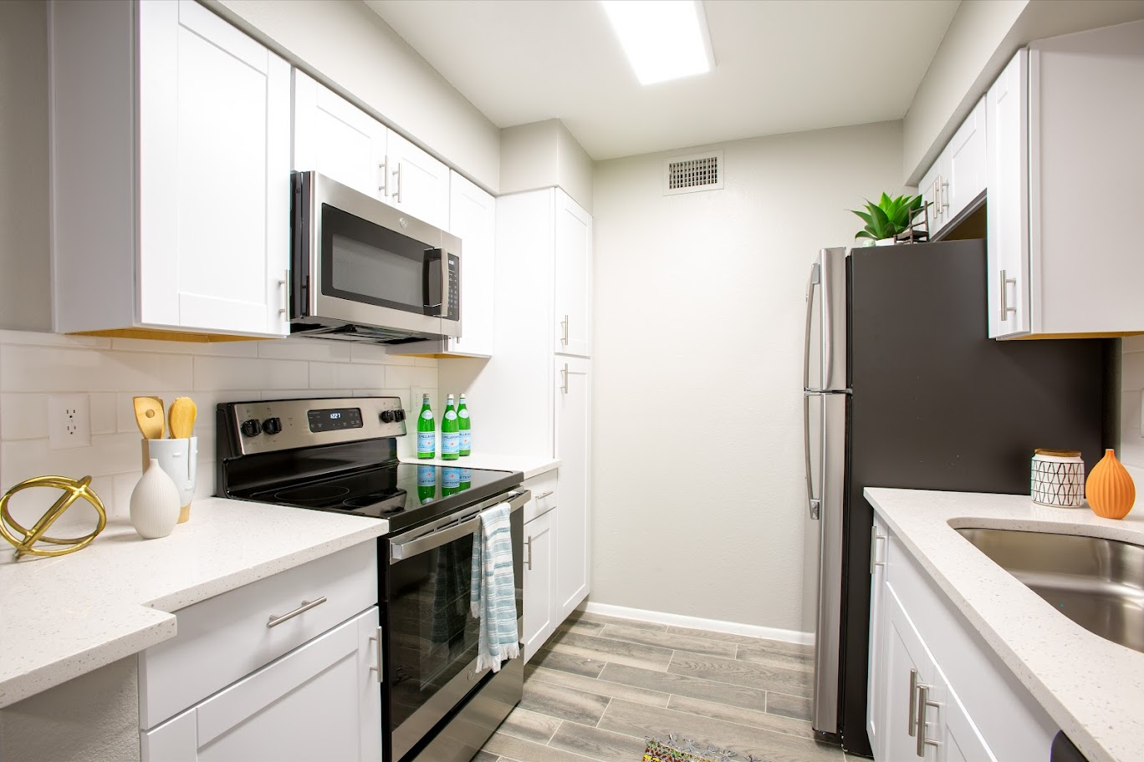
Paseo 51: Unit interiors – Glendale, AZ
Before
After
After
23
RINCONPARTNERS.COM • © 2025 RINCON PARTNERS, LLC

Slide 24
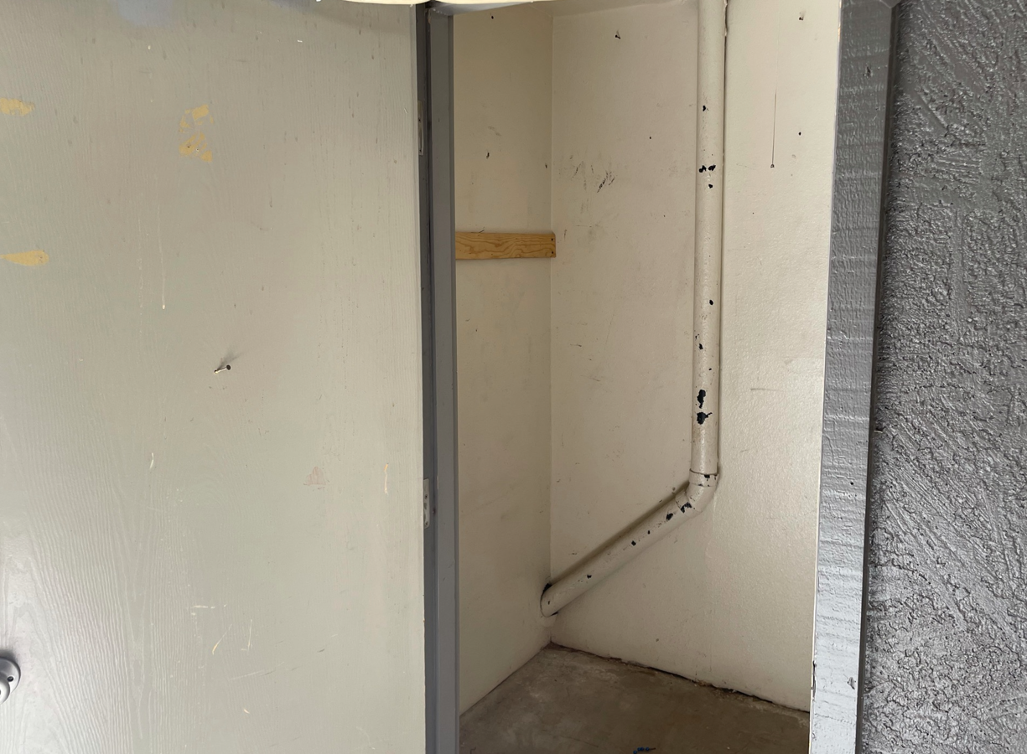
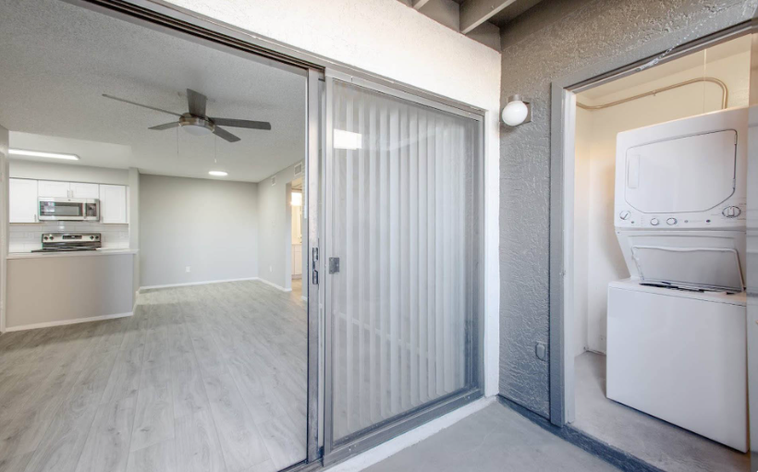
Paseo 51: Washer and dryer addition – Glendale, AZ
Before
After
After
24
RINCONPARTNERS.COM • © 2025 RINCON PARTNERS, LLC

Slide 25
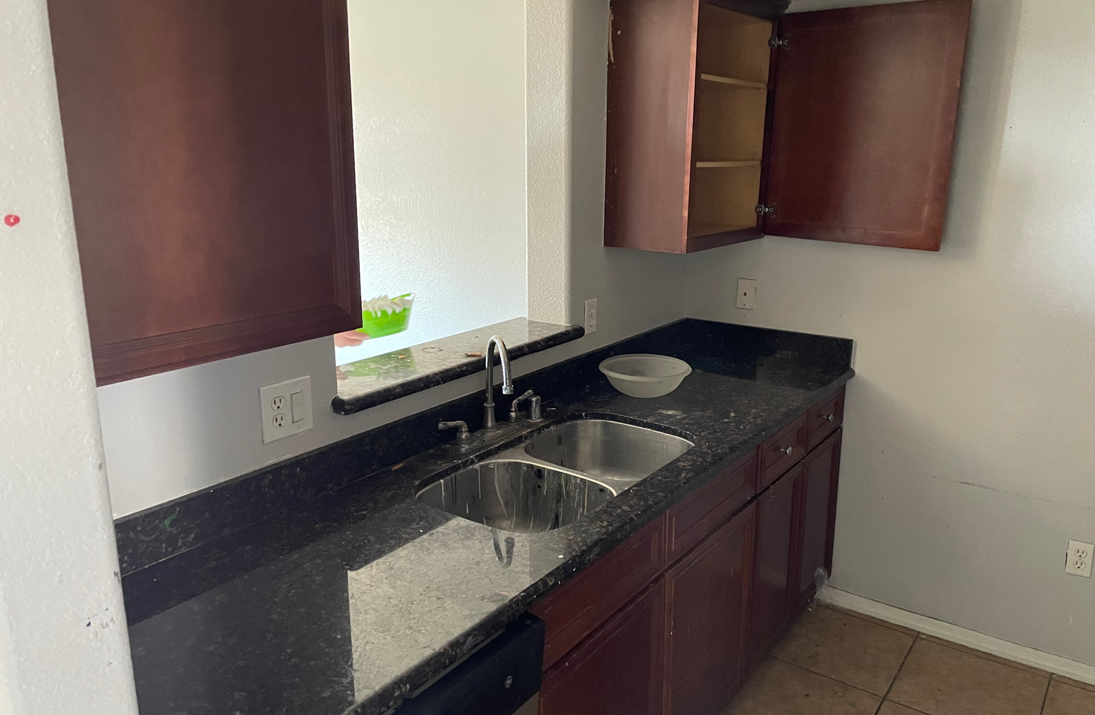
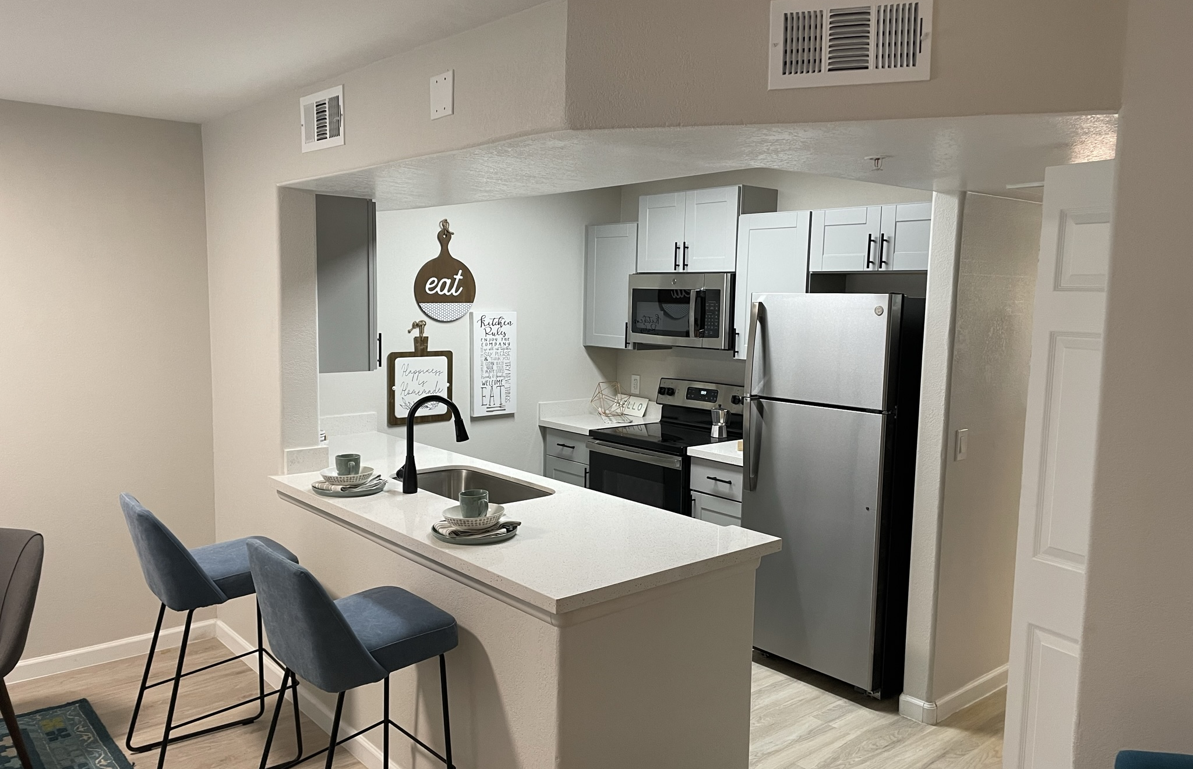
The 60 at Melrose: Unit interiors – Phoenix, AZ
Before
After
After
25
RINCONPARTNERS.COM • © 2025 RINCON PARTNERS, LLC

Slide 26
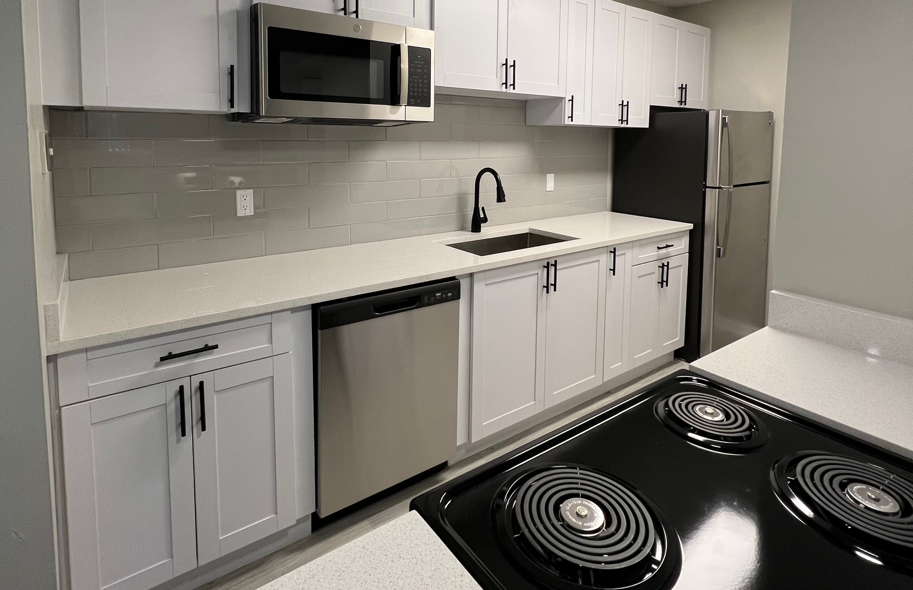
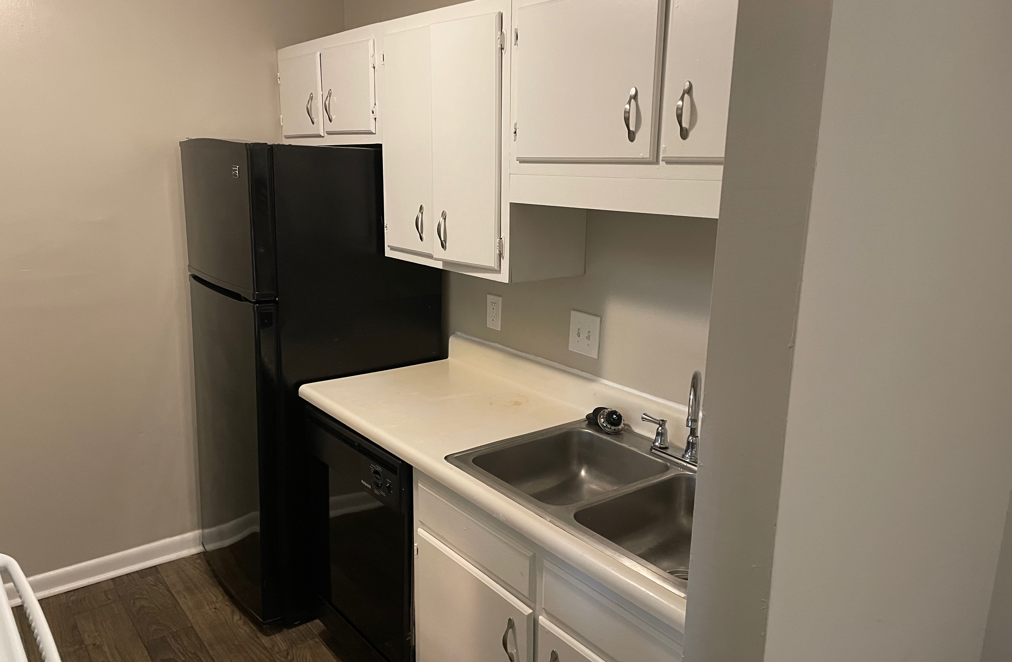
Planters Trace: Unit interiors – Charleston, SC
Before
After
After
26
RINCONPARTNERS.COM • © 2025 RINCON PARTNERS, LLC

